Slide 1
Optimus Octavian
Volvo CoPilot Safe Assist
November 27, 2017

Slide 2
Previous week
Prepare and do the group presentation #1
Group meetings
Prototypes, designs and diagrams

Slide 3
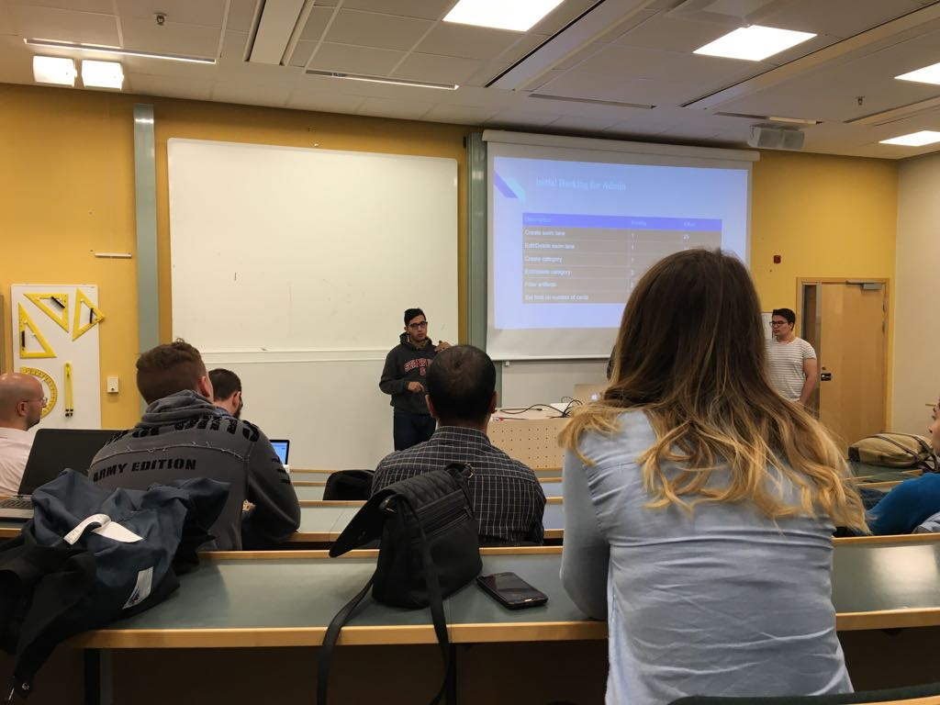
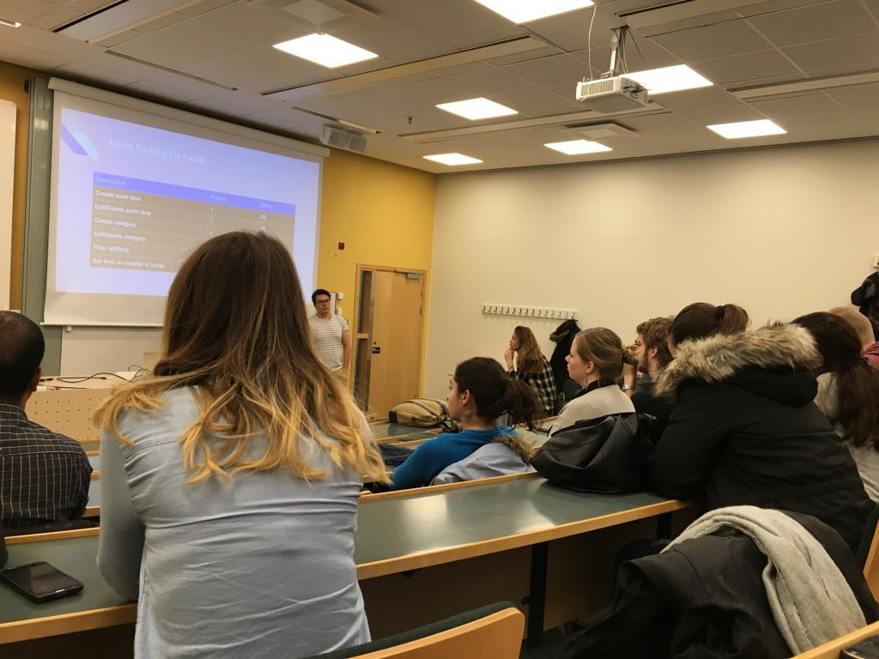
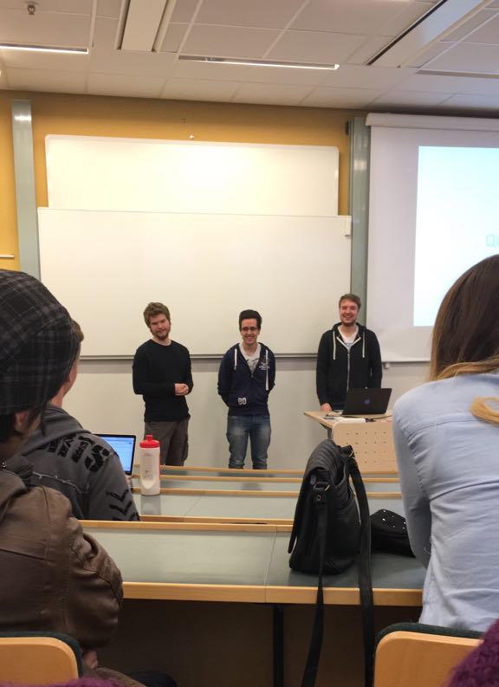
Presentation
Dara, Alvaro and Vasja
Good feedback from the examinators and students
Lessons learned

Slide 4
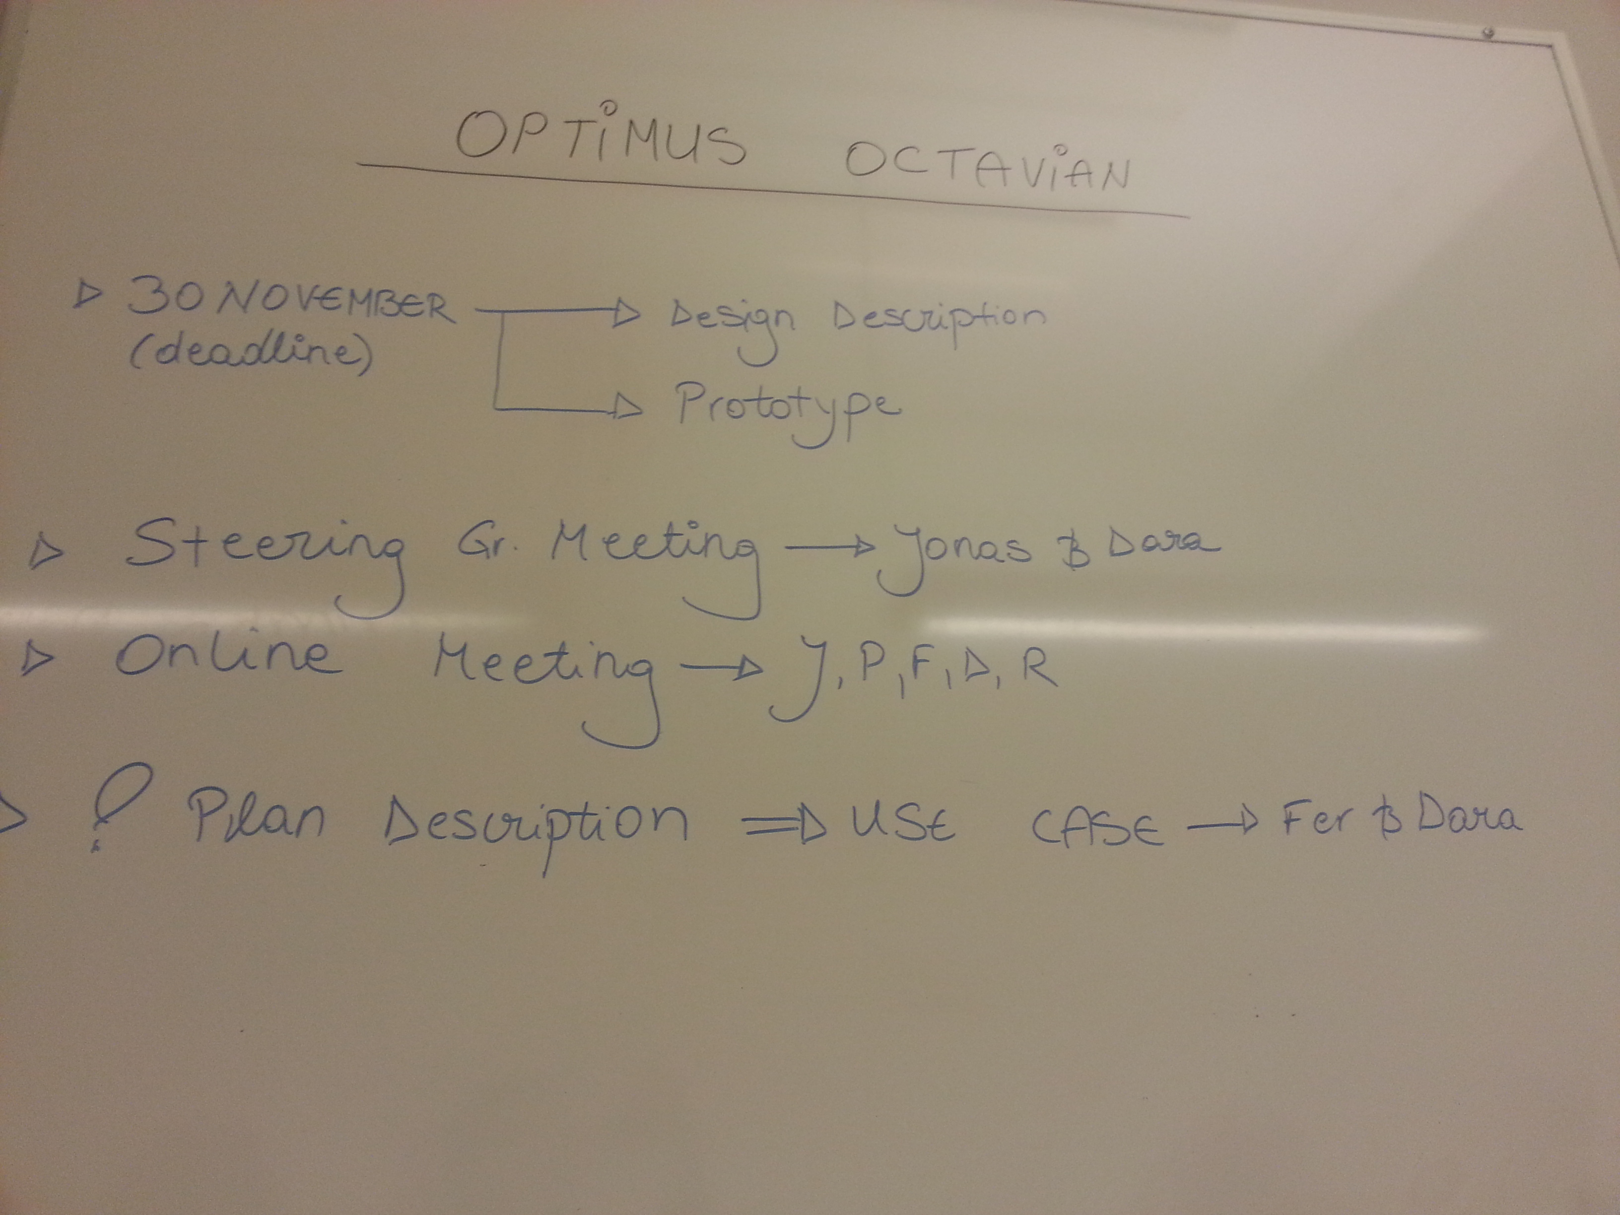
Group meetings
Monday 20/12 - Short meeting to discuss the follow ups
Thursday 23/12 – One and a half hour meeting to talk about what is done and what needs to be done

Slide 5
Prototypes, designs and diagrams
Overview of the Project Plan
Class, use case and state diagrams
Emailing clients - Project proposal sum up and Booking time for meeting with Adnan
Bluetooth research
Code implementation – App skeleton, GPS testing and unit collision

Slide 6
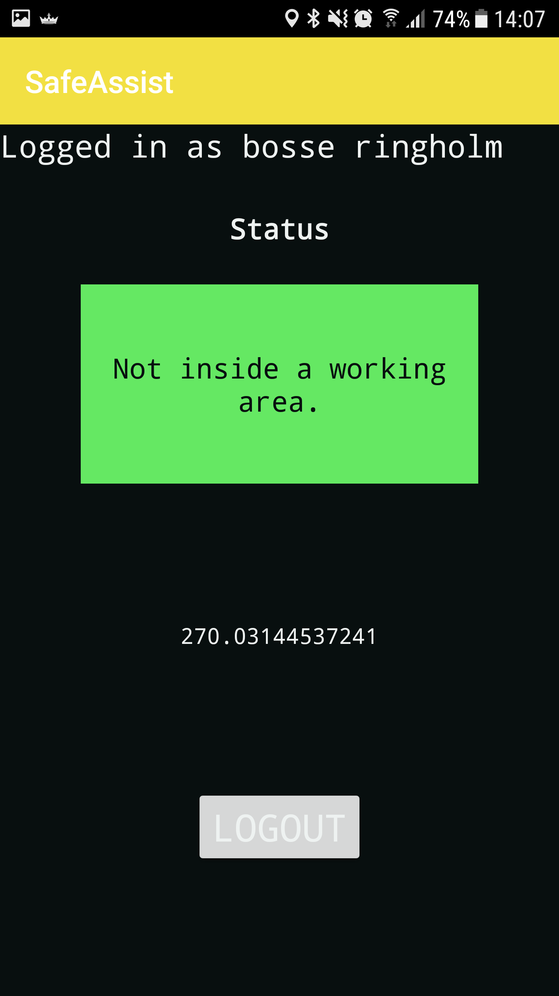
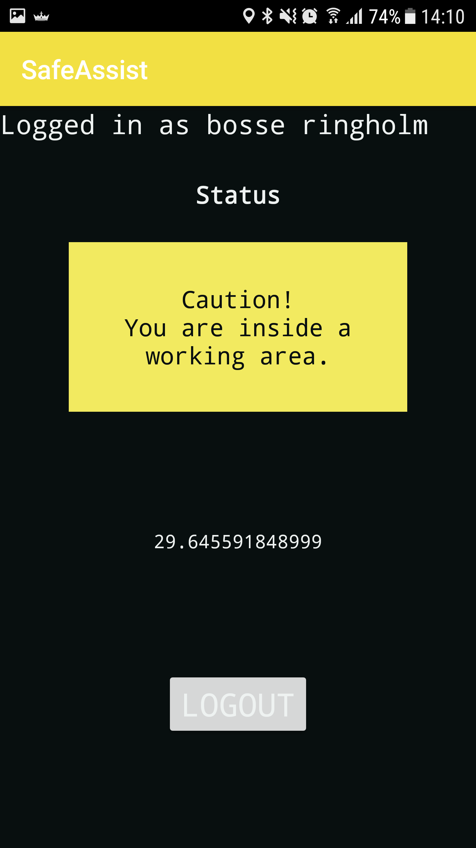
Screenshots

Slide 7
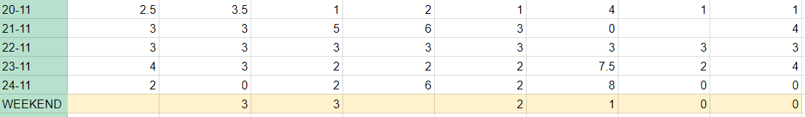
Worked hours
Total: 14.5 15.5 16 19 13 23.5 6 12
From left to right: Álvaro, Dara, Fernando, Jonas, Pablo, Rickard, Sidorela and Vasja. Disclaimer; There was a meeting on Thursday for which some haven´t put in their hours yet…

Slide 8
This week
Design description, first version. (Jonas)
Prototype (backend, frontend). (Rickard)
Sequence diagrams of some specific features. (Dara, Fernando)
Mock-ups (interface) (Sidorela)
Notification tests (vibration, colours, sounds..) (Fernando, Pablo)
System overview (Vasja)
Álvaro worked extra previous week so he could go on a trip this week, YAY for him!

Slide 9
Thank You!

